Slide 1
MediTec at University of Duhok Implementations and Achievements

Slide 2
Implementation of MediTec
We Participated in the project during the period of proposal Writing by active communications with Dr. Riyadh Cashi
During our participation in the Kick off Meeting in Jordan we started communications with different partners of the project. Specially the partners from Malta University.
We had skype meeting with Malta University as they were collecting data regarding the topics of the training .
The Dean of Medicine, Pharmacy, and Dentistry at our university participated actively in putting our the customize requirements for the training that we need for capacity Building.

Slide 3
Several internal meeting was conducted at our university to discus the need assessments.
A joint meeting was conducted at our university with the General Directorate of Health in Duhok represented by the General Director Dr. Nazar Amen and the head of Departments. The need assessment for MediTec were discussed thoroughly.
University of Duhok participated in all the training in Slovakia , Czech, Malta and Germany.
Also we participated in all of the partnership meetings or management meetings.

Slide 4
Training of our students at Czech Republic
Two students from College of Pharmacy , University of Duhok ( Miss. Rand Kalo and Mr. Mohammed Ghareeb) delivered a seminar at their college to introduce their successful participation in MediTec training at a European Partners university , Masaryk University in Brno. The students trained by experienced academic staff at University of Masaryk. The subjects of the training were on a very diverse medical, preclinical and clinical topics like, nursing care, Medical biophysics, Medical Physiology, Experimental medicine, Human anatomy, Forensic Medicine, Surgery and alike.

Slide 5
A seminar was conducted by our participant students after their arrival back . The audiences of student’s seminar were academic staff members and students form the College of Pharmacy at University of Duhok. In the beginning the trained students gave introduction on Erasmus Plus opportunity of the European Union and briefing on University of Masaryk and then they dive in the technical medical topic of the training.
The venue of the activity is our College of pharmacy.
Number of audience are 60.
They are students and staff from our College of Pharmacy.

Slide 6
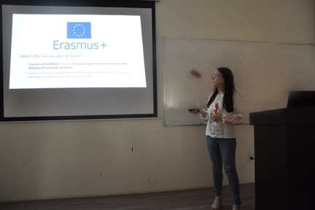

Slide 9
Training of Our students in Slovakia
Slovakia, Masaryk University
Mina Wissam Idwar and Sahand Jameel Khalid, medical students in university of Duhok from Kurdistan region of Iraq.
MediTec project that was hold in Slovakia, aimed to share both theoretical and practical methodological experiences in modern medical education which was done by teachers and doctors in a period of two weeks in Pavol Jozef Safarika university.
A seminar were conducted at our university by our participant students, the audience were around 70 persons .

Slide 10
UoD Conference

Slide 14
UoD Conference
Health Care Service Qulaity Management Concept
9-8 January 2020

Slide 15
The presenters in the conference were Dr. Aleš Bourek and Dr. Erik Staffa
The main themes were:
Health Service Transformation, Health Literacy (What it is and how to train it efficiently).
Medical studies curriculum, specifically in Biophysics.
Quality management and collaboration in health care.

Slide 24
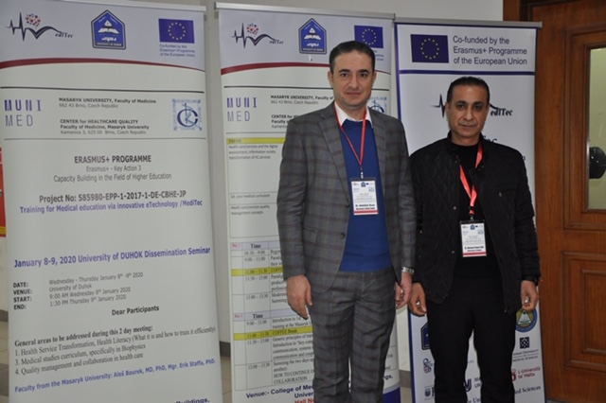

Slide 25
Equipment
New Lab at our College of Medicine

Slide 33
Posters on MediTec on Campus
Dissiminations
Several posters were distributed in different places on campus
College of Medicine, College of Dentistry, College of Pharmacy,
Student Center and President Office.
Poster for the conference at the university of Duhok, conducted by our partner from Slovakia.

Slide 34
For Disseminiation also MedTec was added to the official presentation of the university
MediTec and the opportunity from the EU were mentioned in every meeting or with every delegations we have.
We have all the details of MediTec on our website, we built a link that have all the information. https://uod.ac/int-relations/erasmusplus/meditec/

Slide 35
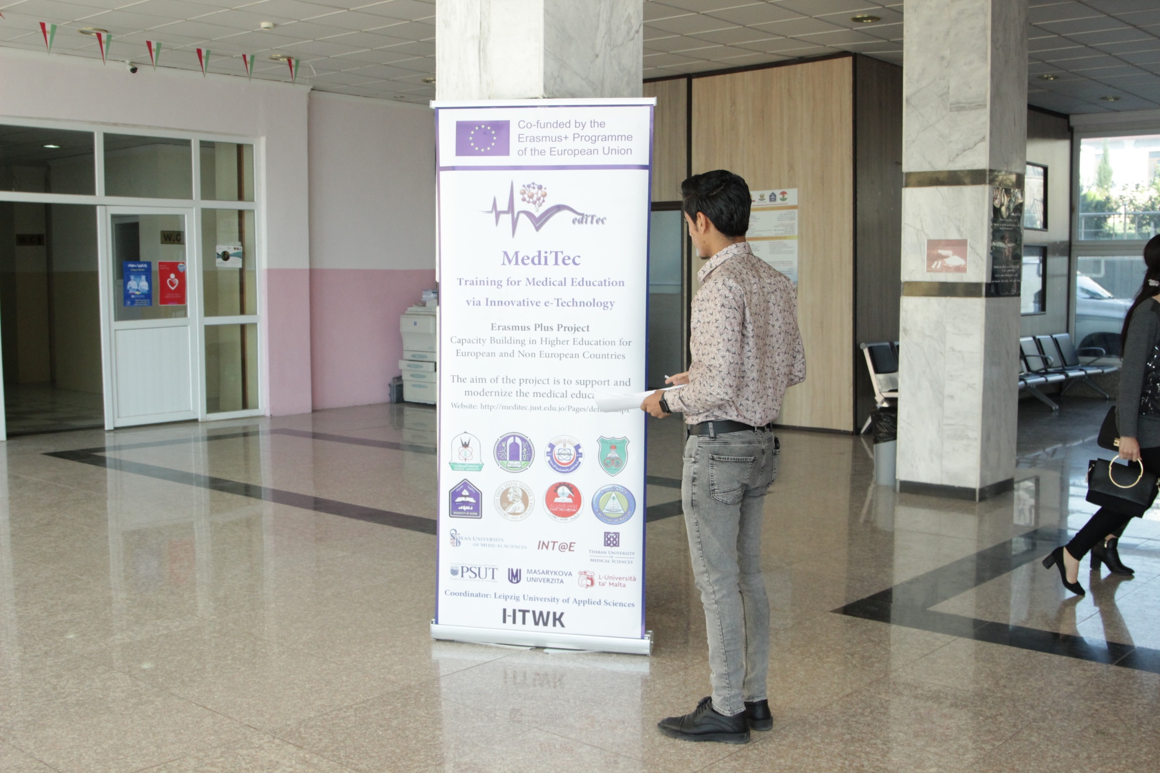

Slide 36
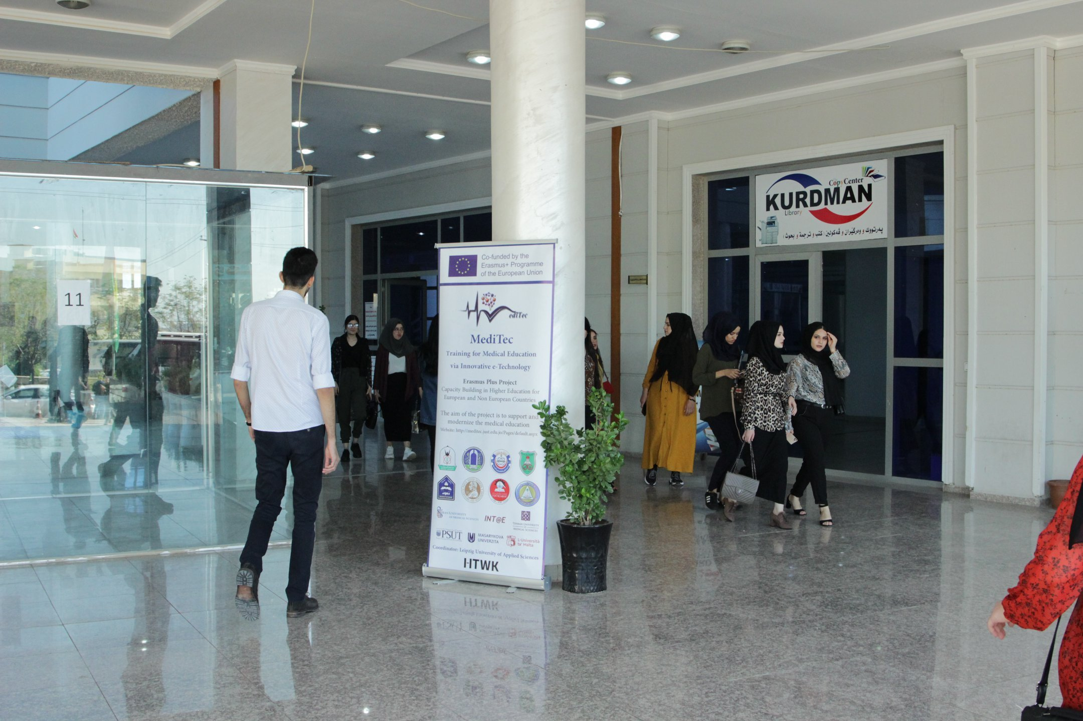

Slide 38
Co-Funding by UoD
University of Duhok participated actively in co-funding the project by:
Prepare lab for the equipment.
Furniture for the lab.
Local transport for equipment, paperwork for taxes.
Assigned one person to be responsible for the equipment as part of their job at our university.
Co-fund every and each travel of every participant through local transport, visas and beyond or co-funding in airfare.

Slide 39
Our Achievements from Meditec
Training of trainers, Training our staff on innovative technologies in EU universities, Masaryk University, Brno University, University of Malta and University of Leipzig. The Trained Staff are from College of Medicine, Pharmacy and Dentistry.
Training of Students, on new Technologies in different universities from different partners countries, Brno University, Masaryk University and University of Jordan. The participants are from College of Medicine and College of Pharmacy.
The University of Duhok adopted the continuous training on innovative technology in teaching process.
Participants enhanced their different teaching methodologies after receiving the equipment.

Slide 40
Development of practical courses especially for this new learning environment ( after receiving the equipments).
Enhancement of the curriculum in some subjects.
Strengthening the quality of our graduate students through implementing new technologies.
New lab with new equipment has been established.
Conference were conducted at our university with the presence of almost 70 participants of our medical academic staff from different medical colleges.
Dissemination of MediTec among our university community and beyond like the Directorate General of Health in Duhok and its professional staff.

Slide 41
Thank you

